Slide 1

Automation Testing
By- Manas

Slide 2
WORKING WITH SIMILAR MULTIPLE ELEMENTS
For identifying one element in application, we are using “findelement” method based on unique locator of the element. For working on multiple elements, we need to identify them by using “findElements” method based on common locators. All identified elements will be stored into list<WebElement> collection.
Note:
For similar elements like (Buttons, Links, Images, check-boxes), Tag name is the common locator.
Syntax:
List<WebElement> var = driver. findelements(by. tagname(“Value”));

Slide 3
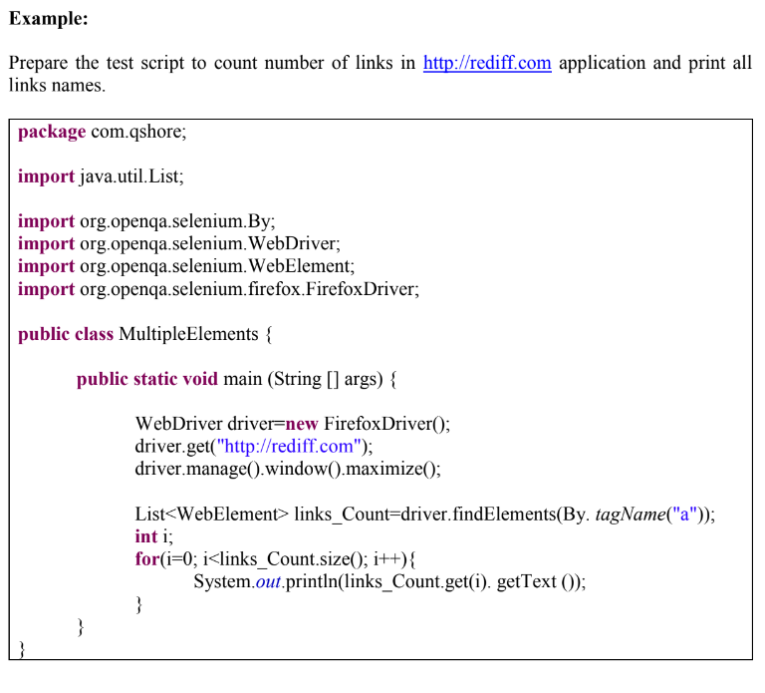
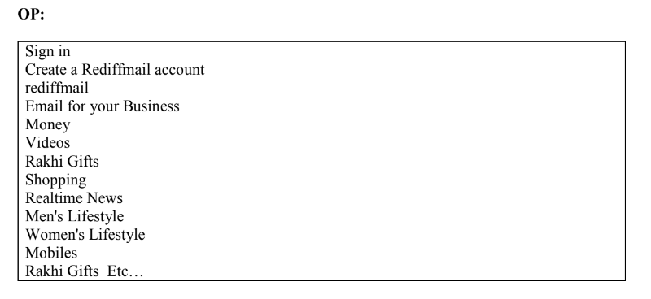

Slide 4
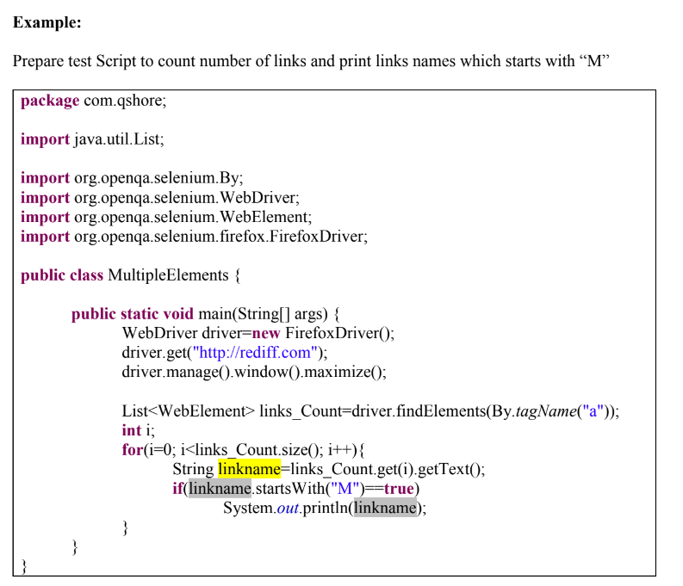
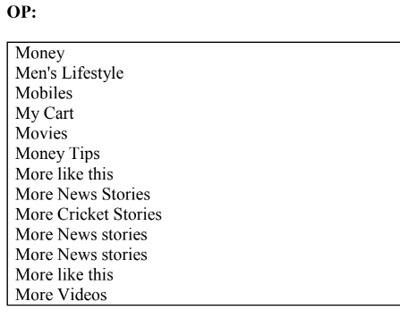

Slide 5
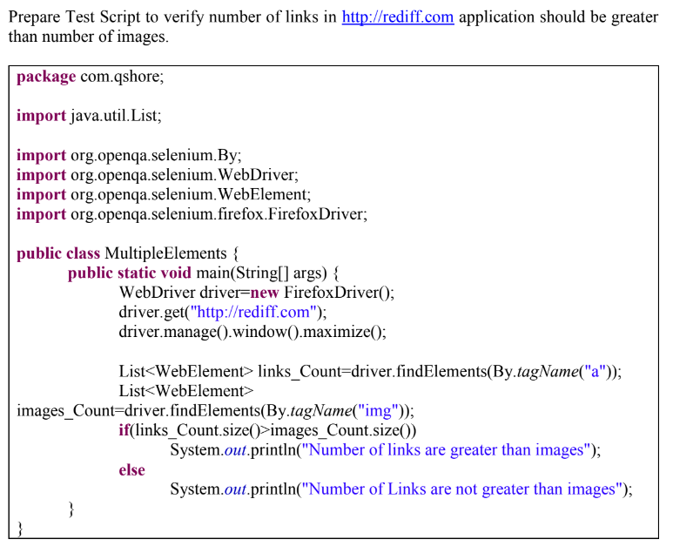

Slide 6
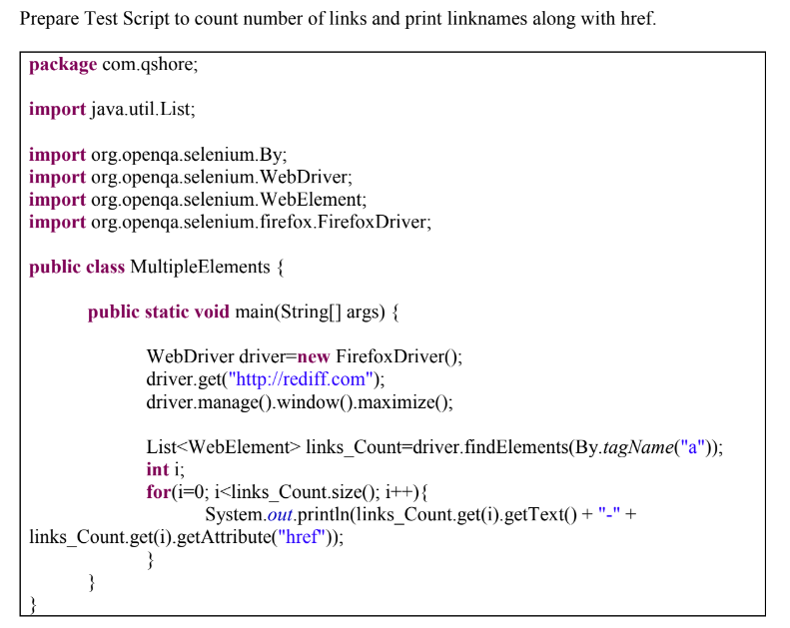
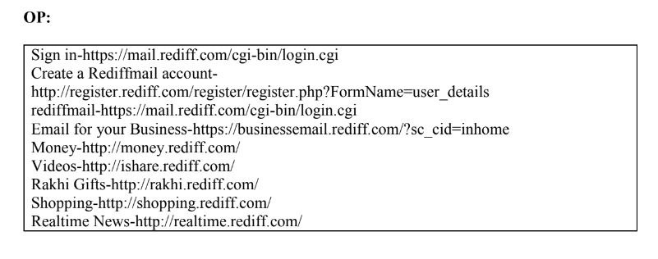

Slide 7
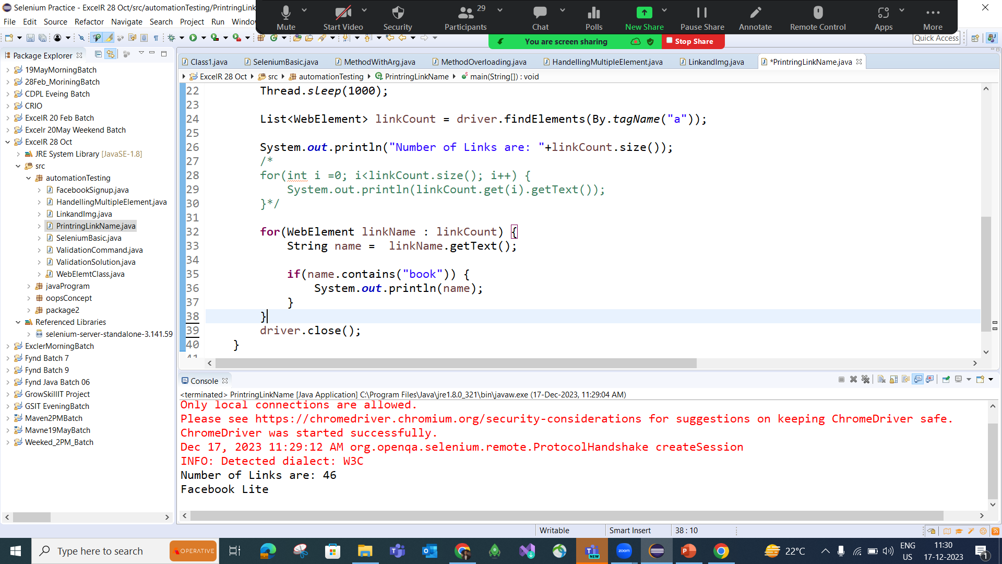

Slide 8
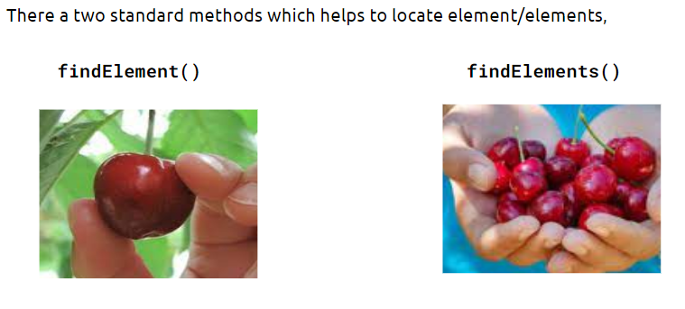
findElement() Vs findElements() method

Slide 9
FAQ’s
1. Count number of links in app and print all names of links
2. Verify Number of links should be greater than number of buttons in app
3. What is the difference between “findElement” and “findElements”
4. What is the difference between common and Unique locators
5. Count number of links and export all links to Excel
6. Write a program to count number of links and click on last but one link

